Slide 1


Slide 2


Slide 3
2015-16 Top10 Giving Countries
Rank | Country | Rotarians | Annual Fund | Annual Fund Per Capita | PolioPlus Fund | Other Funds | Endowment Fund | Total Contributions
1 | United States | 328827 | $43,711,779 | $132.93 | $80,328,885 | $4,620,964 | $7,614,544 | $136,276,172
2 | India | 132200 | $8,940,925 | $67.63 | $1,840,139 | $3,651,348 | $943,863 | $15,376,275
3 | Japan | 87287 | $11,900,030 | $136.33 | $1,825,954 | $188,051 | $1,324,402 | $15,238,437
4 | Korea | 60599 | $12,512,611 | $206.48 | $106,695 | $343,315 | $1,065,728 | $14,028,349
5 | Taiwan | 32670 | $5,132,755 | $157.11 | $372,217 | $908,906 | $2,324,530 | $8,738,408
6 | Canada | 24326 | $3,734,680 | $153.53 | $1,838,380 | $1,060,798 | $923,634 | $7,557,492
7 | Germany | 53579 | $4,024,652 | $75.12 | $1,420,264 | $442,341 | $0 | $5,887,257
8 | Australia | 29673 | $3,731,265 | $125.75 | $1,455,192 | $169,566 | $53,913 | $5,409,936
9 | UK | 47615 | $2,965,687 | $62.28 | $1,177,509 | $404,436 | $99,824 | $4,647,456
10 | Italy | 39592 | $2,766,106 | $69.87 | $1,056,259 | $226,148 | $130,378 | $4,178,891

Slide 4
2016-17 Top10 Giving Countries
Rank | Country | Rotarians | Annual Fund | Annual Fund Per Capita | PolioPlus Fund | Other Funds | Endowment Fund | Total Contributions
1 | United States | 325463 | $47,869,147 | $147.08 | $88,223,912 | $4,960,707 | $12,496,574 | $153,550,340
2 | India | 135824 | $10,268,053 | $75.60 | $1,923,479 | $5,454,914 | $2,368,171 | $20,014,617
3 | Japan | 87431 | $13,229,246 | $151.31 | $2,168,072 | $288,678 | $2,002,602 | $17,688,598
4 | Korea | 60283 | $13,940,197 | $231.25 | $328,318 | $461,774 | $1,788,433 | $16,518,722
5 | Taiwan | 32355 | $6,779,564 | $209.54 | $931,691 | $854,840 | $2,031,426 | $10,597,521
6 | Canada | 23778 | $4,190,572 | $176.24 | $1,650,534 | $1,246,322 | $1,292,406 | $8,379,834
7 | Germany | 54570 | $4,522,550 | $82.88 | $1,599,347 | $206,454 | $0 | $6,328,351
8 | UK | 46265 | $2,502,864 | $54.10 | $1,450,090 | $221,746 | $1,858,088 | $6,032,788
9 | Australia | 28912 | $3,811,065 | $131.82 | $1,114,016 | $166,632 | $277,616 | $5,369,329
10 | Philippines | 23043 | $4,042,320 | $175.43 | $266,872 | $92,960 | $17,001 | $4,419,153

Slide 5


Slide 6
捐獻排名 | Zone | District | Members | District Goal | AF Per Capita | Annual Fund * | Polio Plus | Other Giving | Endowment Fund | Total Contributions
1 | 5 | 3190 | 3,868 | 500,588 | $358.41 | 1,386,326.22 | 202,011.14 | 612,790.49 | 25,000.00 | 2,226,127.85
2 | 4 | 3140 | 7,317 | 895,947 | $164.26 | 1,201,919.82 | 76,594.14 | 481,847.18 | 243,169.60 | 2,003,530.74
3 | 10 | 3500 | 5,381 | 1,111,108 | $232.37 | 1,250,403.20 | 39,300.00 | 124,160.80 | 587,400.00 | 2,001,264.00
4 | 10 | 3520 | 6,103 | 852,817 | $141.29 | 862,285.53 | 78,509.51 | 221,350.00 | 744,900.00 | 1,907,045.04
5 | 26 | 5340 | 3,173 | 257,260 | $165.39 | 524,772.06 | 135,894.10 | 412,155.71 | 766,583.59 | 1,839,405.46
6 | 9 | 3630 | 6,220 | 313,600 | $220.87 | 1,373,833.38 | 6,467.84 | 28,900.07 | 0.00 | 1,409,201.29
7 | 10 | 3480 | 4,867 | 980,665 | $152.11 | 740,322.00 | 93,400.00 | 124,625.00 | 373,530.00 | 1,331,877.00
8 | 9 | 3690 | 2,875 | 375,865 | $430.52 | 1,237,730.89 | 11,100.01 | 16,300.05 | 49,000.02 | 1,314,130.97
9 | 34 | 6900 | 4,280 | 636,594 | $198.86 | 851,102.20 | 368,594.81 | 27,750.00 | 66,662.96 | 1,314,109.97
10 | 9 | 3750 | 3,160 | 604,022 | $397.76 | 1,256,935.72 | 10.00 | 0.00 | 17,000.08 | 1,273,945.80
11 | 9 | 3600 | 3,536 | 1,144,500 | $304.66 | 1,077,274.41 | 26,899.98 | 8,574.31 | 133,200.04 | 1,245,948.74
12 | 24 | 5360 | 1,946 | 176,405 | $459.51 | 894,215.44 | 106,097.31 | 175,687.37 | 46,113.46 | 1,222,113.58
13 | 6 | 3292 | 3,026 | 225,205 | $79.09 | 239,312.49 | 4,318.87 | 942,425.01 | 0.00 | 1,186,056.37
14 | 10 | 3510 | 3,865 | 861,676 | $173.61 | 671,005.50 | 50,100.00 | 157,814.70 | 299,500.00 | 1,178,420.20
15 | 10 | 3490 | 4,919 | 772,279 | $138.26 | 680,108.00 | 59,910.35 | 186,200.00 | 243,000.00 | 1,169,218.35
16 | 26 | 5330 | 2,078 | 390,167 | $168.03 | 349,162.82 | 55,935.69 | 48,711.00 | 710,000.00 | 1,163,809.51
17 | 34 | 6960 | 2,229 | 564,206 | $370.19 | 825,161.67 | 81,751.92 | 60,131.55 | 176,618.19 | 1,143,663.33
18 | 9 | 3620 | 3,767 | 138,600 | $250.27 | 942,777.23 | 4,016.34 | 64,250.13 | 129,999.93 | 1,141,043.63
19 | 2 | 2750 | 4,740 | 576,311 | $159.35 | 755,326.41 | 148,551.98 | 71,650.05 | 101,680.96 | 1,077,209.40
20 | 3 | 2650 | 4,597 | 368,890 | $190.16 | 874,186.36 | 79,436.45 | 1,050.00 | 120,916.66 | 1,075,589.47

Slide 7
捐獻排名 | Zone | District | Members | District Goal | AF Per Capita | Annual Fund * | Polio Plus | Other Giving | Endowment Fund | Total Contributions
21 | 25 | 5020 | 4,708 | 555,930 | $133.87 | 630,253.50 | 229,600.59 | 107,198.70 | 104,205.20 | 1,071,257.99
22 | 26 | 5170 | 3,806 | 671,420 | $182.22 | 693,513.39 | 170,095.13 | 152,546.35 | 1,525.00 | 1,017,679.87
23 | 5 | 3230 | 6,096 | 301,528 | $63.56 | 387,466.09 | 36,222.59 | 542,372.96 | 50,218.76 | 1,016,280.40
24 | 10 | 3590 | 3,796 | 1,360,486 | $242.79 | 921,628.30 | 24,000.00 | 49,860.20 | 18,000.00 | 1,013,488.50
25 | 4 | 3030 | 4,814 | 78,335 | $42.57 | 204,910.14 | 17,221.52 | 766,831.62 | 20,000.00 | 1,008,963.28
26 | 33 | 7770 | 4,021 | 759,440 | $198.14 | 796,731.93 | 104,426.71 | 4,150.00 | 66,381.00 | 971,689.64
27 | 26 | 5300 | 2,325 | 299,924 | $159.89 | 371,752.13 | 85,185.11 | 51,876.30 | 439,173.19 | 947,986.73
28 | 28 | 5950 | 2,812 | 693,422 | $273.13 | 768,051.12 | 104,349.96 | 61,350.45 | 10,184.60 | 943,936.13
29 | 21 | 4370 | 1,172 | 146,394 | $656.35 | 769,238.22 | 36,513.61 | 0.00 | 120,948.15 | 926,699.98
30 | 33 | 7680 | 2,740 | 335,278 | $168.63 | 462,039.09 | 85,192.28 | 29,000.00 | 336,349.12 | 912,580.49
31 | 19 | 2000 | 4,340 | 10,900 | $54.54 | 236,704.38 | 558,715.14 | 114,700.00 | 0.00 | 910,119.52
32 | 26 | 5320 | 1,868 | 227,365 | $205.06 | 383,054.36 | 116,279.25 | 116,100.00 | 284,104.02 | 899,537.63
33 | 1 | 2770 | 2,550 | 319,932 | $205.80 | 524,782.64 | 146,119.31 | 21,533.80 | 197,296.35 | 889,732.10
34 | 26 | 5280 | 2,527 | 341,885 | $181.61 | 458,923.03 | 95,935.09 | 30,763.70 | 257,845.00 | 843,466.82
35 | 21 | 5870 | 2,649 | 500,072 | $204.20 | 540,935.27 | 76,661.45 | 10,934.48 | 211,670.82 | 840,202.02
36 | 24 | 5370 | 2,266 | 324,655 | $145.90 | 330,613.53 | 201,431.26 | 37,181.88 | 261,139.46 | 830,366.13
37 | 2 | 2760 | 4,756 | 611,266 | $152.24 | 724,062.38 | 49,882.30 | 0.00 | 53,758.02 | 827,702.70
38 | 26 | 5000 | 1,709 | 283,720 | $265.18 | 453,193.36 | 50,345.99 | 20,755.85 | 303,091.88 | 827,387.08
39 | 3 | 2660 | 3,568 | 332,371 | $165.29 | 589,740.17 | 144,083.69 | 34,937.20 | 49,948.39 | 818,709.45
40 | 10 | 3460 | 5,251 | 596,973 | $126.33 | 663,365.00 | 45,637.00 | 56,575.00 | 46,200.00 | 811,777.00
194 | 10 | 3470 | 2,284 | 125,700 | $116.18 | 265,362.00 | 6,000.00 | 36,080.00 | 31,000.00 | 338,442.00

Slide 8


Slide 9
捐獻排名 | Zone | District | Members | District Goal | AF Per Capita | Annual Fund * | Polio Plus | Other Giving | Endowment Fund | Total Contributions
1 | 29 | 7360 | 2,538 | 110,741 | $78.21 | 198,500.81 | 5,055,443.79 | 1,105.00 | 3,500.50 | 5,258,550.10
2 | 4 | 3141 | 4,741 | 1,140,627 | $337.32 | 1,599,229.33 | 98,850.96 | 882,291.23 | 140,807.39 | 2,721,178.91
3 | 10 | 3490 | 5,050 | 863,069 | $265.45 | 1,340,540.00 | 181,305.00 | 241,865.00 | 336,520.00 | 2,100,230.00
4 | 10 | 3500 | 5,698 | 1,681,893 | $224.97 | 1,281,903.24 | 185,846.00 | 129,837.05 | 465,757.25 | 2,063,343.54
5 | 10 | 3520 | 5,916 | 909,192 | $159.71 | 944,842.45 | 146,610.65 | 150,954.71 | 804,550.00 | 2,046,957.81
6 | 18 | 1240 | 1,544 | 3,625 | $49.62 | 76,606.66 | 50,589.78 | 14,949.33 | 1,802,225.52 | 1,944,371.29
7 | 9 | 3630 | 6,190 | 342,700 | $255.05 | 1,578,764.79 | 81,090.85 | 48,900.02 | 30,000.06 | 1,738,755.72
8 | 25 | 5150 | 1,784 | 312,390 | $321.78 | 574,050.45 | 103,526.85 | 22,114.48 | 1,013,003.00 | 1,712,694.78
9 | 4 | 3011 | 2,949 | 700,500 | $215.86 | 636,577.86 | 55,922.22 | 515,207.04 | 499,000.02 | 1,706,707.14
10 | 24 | 5360 | 1,889 | 173,750 | $518.62 | 979,672.98 | 194,207.14 | 218,035.99 | 277,940.78 | 1,669,856.89
11 | 21 | 5810 | 2,665 | 126,373 | $131.59 | 350,686.47 | 51,509.00 | 12,430.90 | 1,166,179.26 | 1,580,805.63
12 | 31 | 6040 | 2,432 | 321,250 | $558.69 | 1,358,744.26 | 83,899.91 | 3,286.05 | 120,191.42 | 1,566,121.64
13 | 5 | 3190 | 5,574 | 396,257 | $175.58 | 978,673.01 | 73,380.31 | 467,720.59 | 1,150.45 | 1,520,924.36
14 | 9 | 3750 | 3,744 | 269,750 | $355.45 | 1,330,797.18 | 0.00 | 22,050.00 | 91,578.85 | 1,444,426.03
15 | 27 | 5440 | 3,037 | 297,450 | $134.13 | 407,363.64 | 139,438.39 | 39,826.50 | 852,686.63 | 1,439,315.16
16 | 10 | 3480 | 4,741 | 682,120 | $204.79 | 970,927.65 | 107,810.00 | 152,446.70 | 196,500.00 | 1,427,684.35
17 | 25 | 5030 | 2,617 | 268,390 | $252.17 | 659,940.41 | 70,475.67 | 9,525.00 | 647,105.86 | 1,387,046.94
18 | 2 | 2750 | 4,805 | 645,847 | $171.90 | 825,985.18 | 204,840.84 | 17,871.63 | 296,265.47 | 1,344,963.12
19 | 9 | 3600 | 3,484 | 672,400 | $316.09 | 1,101,262.73 | 5,585.43 | 18,290.02 | 213,554.42 | 1,338,692.60
20 | 25 | 5110 | 3,593 | 582,465 | $171.93 | 617,734.83 | 142,176.24 | 34,912.50 | 530,442.16 | 1,325,265.73

Slide 10
捐獻排名 | Zone | District | Members | District Goal | AF Per Capita | Annual Fund * | Polio Plus | Other Giving | Endowment Fund | Total Contributions
21 | 10 | 3590 | 3,940 | 396,800 | $292.31 | 1,151,712.66 | 49,900.03 | 78,800.01 | 22,000.02 | 1,302,412.72
22 | 10 | 3510 | 3,714 | 651,378 | $248.92 | 924,477.94 | 143,300.00 | 84,737.00 | 109,900.00 | 1,262,414.94
23 | 30 | 6860 | 3,469 | 398,850 | $123.85 | 429,647.95 | 106,663.08 | 543,000.00 | 172,825.00 | 1,252,136.03
24 | 25 | 5020 | 4,613 | 603,445 | $160.57 | 740,692.82 | 245,332.12 | 85,905.27 | 168,842.72 | 1,240,772.93
25 | 10 | 3460 | 5,105 | 690,600 | $171.82 | 877,144.07 | 155,111.00 | 62,825.00 | 90,700.00 | 1,185,780.07
26 | 3 | 2650 | 4,588 | 329,074 | $206.67 | 948,200.44 | 92,753.02 | 13,736.21 | 123,564.58 | 1,178,254.25
27 | 33 | 7770 | 3,986 | 752,998 | $208.41 | 830,718.32 | 116,634.86 | 15,525.00 | 191,571.16 | 1,154,449.34
28 | 6 | 3350 | 2,839 | 440,350 | $292.22 | 829,622.71 | 61,116.44 | 108,949.69 | 121,000.00 | 1,120,688.84
29 | 10 | 3662 | 3,224 | 552,680 | $300.38 | 968,429.58 | 0.00 | 13,125.00 | 126,125.70 | 1,107,680.28
30 | 34 | 6900 | 4,277 | 594,076 | $163.03 | 697,292.43 | 261,133.31 | 22,434.36 | 119,350.00 | 1,100,210.10
31 | 26 | 5340 | 3,097 | 341,750 | $170.49 | 528,019.11 | 180,684.36 | 124,444.75 | 260,713.89 | 1,093,862.11
32 | 30 | 6780 | 3,145 | 379,331 | $225.28 | 708,500.82 | 205,742.74 | 62,557.85 | 112,082.27 | 1,088,883.68
33 | 3 | 2660 | 3,576 | 314,948 | $184.90 | 661,192.39 | 211,820.80 | 96,294.47 | 115,118.18 | 1,084,425.84
34 | 5 | 3000 | 4,637 | 330,507 | $148.01 | 686,313.38 | 36,481.57 | 174,105.03 | 181,618.20 | 1,078,518.18
35 | 27 | 5420 | 1,810 | 195,400 | $209.88 | 379,882.68 | 347,900.83 | 5,652.35 | 340,812.38 | 1,074,248.24
36 | 26 | 5240 | 3,341 | 445,050 | $173.01 | 578,028.40 | 140,377.17 | 127,300.03 | 204,916.51 | 1,050,622.11
37 | 7 | 3830 | 2,701 | 324,106 | $338.42 | 914,069.91 | 78,550.56 | 53,533.59 | 1,500.00 | 1,047,654.06
38 | 2 | 2760 | 4,743 | 669,879 | $185.60 | 880,323.75 | 61,551.45 | 0.00 | 100,459.79 | 1,042,334.99
39 | 4 | 3131 | 5,071 | 452,314 | $84.42 | 428,084.76 | 62,874.32 | 355,080.77 | 195,227.54 | 1,041,267.39
40 | 9 | 3670 | 4,267 | 43,500 | $225.99 | 964,311.33 | 2,100.00 | 67,500.01 | 7,000.01 | 1,040,911.35
137 | 10 | 3470 | 2,131 | 318,210 | $206.23 | 439,474.50 | 10,700.00 | 30,075.00 | 27,498.86 | 507,748.36
208 | 7 | 3790 | 2,612 | 200,889 | $132.71 | 346,646.22 | 12,419.99 | 0.00 | 1,001.00 | 360,067.21

Slide 11


Slide 12
社友排名 | Zone | District | Members | District Goal | AF Per Capita | Annual Fund * | Polio Plus | Other Giving | Endowment Fund | Total Contributions
1 | 4 | 3140 | 7,317 | 895,947 | $164.26 | 1,201,919.82 | 76,594.14 | 481,847.18 | 243,169.60 | 2,003,530.74
2 | 9 | 3630 | 6,220 | 313,600 | $220.87 | 1,373,833.38 | 6,467.84 | 28,900.07 | 0.00 | 1,409,201.29
3 | 10 | 3520 | 6,103 | 852,817 | $141.29 | 862,285.53 | 78,509.51 | 221,350.00 | 744,900.00 | 1,907,045.04
4 | 5 | 3230 | 6,096 | 301,528 | $63.56 | 387,466.09 | 36,222.59 | 542,372.96 | 50,218.76 | 1,016,280.40
5 | 5 | 3180 | 5,561 | 93,813 | $50.21 | 279,201.20 | 4,205.51 | 3,858.02 | 25,000.00 | 312,264.73
6 | 4 | 3131 | 5,548 | 372,245 | $65.64 | 364,174.09 | 13,583.44 | 124,317.03 | 9,810.99 | 511,885.55
7 | 10 | 3500 | 5,381 | 1,111,108 | $232.37 | 1,250,403.20 | 39,300.00 | 124,160.80 | 587,400.00 | 2,001,264.00
8 | 10 | 3460 | 5,251 | 596,973 | $126.33 | 663,365.00 | 45,637.00 | 56,575.00 | 46,200.00 | 811,777.00
9 | 5 | 3202 | 5,053 | 66,987 | $30.42 | 153,706.50 | 7,449.67 | 525.00 | 0.00 | 161,681.17
10 | 5 | 3201 | 5,003 | 387,747 | $71.90 | 359,694.00 | 116,642.86 | 11,482.57 | 1,000.00 | 488,819.43
11 | 5 | 3170 | 4,989 | 263,114 | $52.86 | 263,711.48 | 12,003.12 | 84,245.51 | 0.00 | 359,960.11
12 | 6 | 3281 | 4,982 | 414,210 | $32.65 | 162,678.28 | 675.00 | 78,761.94 | 14,913.33 | 257,028.55
13 | 10 | 3490 | 4,919 | 772,279 | $138.26 | 680,108.00 | 59,910.35 | 186,200.00 | 243,000.00 | 1,169,218.35
14 | 10 | 3480 | 4,867 | 980,665 | $152.11 | 740,322.00 | 93,400.00 | 124,625.00 | 373,530.00 | 1,331,877.00
15 | 4 | 3030 | 4,814 | 78,335 | $42.57 | 204,910.14 | 17,221.52 | 766,831.62 | 20,000.00 | 1,008,963.28
16 | 2 | 2760 | 4,756 | 611,266 | $152.24 | 724,062.38 | 49,882.30 | 0.00 | 53,758.02 | 827,702.70
17 | 2 | 2750 | 4,740 | 576,311 | $159.35 | 755,326.41 | 148,551.98 | 71,650.05 | 101,680.96 | 1,077,209.40
18 | 25 | 5020 | 4,708 | 555,930 | $133.87 | 630,253.50 | 229,600.59 | 107,198.70 | 104,205.20 | 1,071,257.99
19 | 5 | 3000 | 4,695 | 94,214 | $119.09 | 559,123.55 | 2,525.00 | 0.00 | 0.00 | 561,648.55
20 | 3 | 2650 | 4,597 | 368,890 | $190.16 | 874,186.36 | 79,436.45 | 1,050.00 | 120,916.66 | 1,075,589.47
21 | 12 | 2060 | 4,492 | 107,494 | $47.42 | 213,020.27 | 75,765.02 | 64,610.85 | 621.49 | 354,017.63

Slide 13
社友排名 | Zone | District | Members | District Goal | AF Per Capita | Annual Fund * | Polio Plus | Other Giving | Endowment Fund | Total Contributions
22 | 13 | 1990 | 4,458 | 5,000 | $56.35 | 251,227.70 | 126,629.03 | 6,766.67 | 1,000.00 | 385,623.40
23 | 5 | 2981 | 4,415 | 140,160 | $35.98 | 158,835.37 | 24,677.35 | 0.00 | 11,197.00 | 194,709.72
24 | 19 | 2000 | 4,340 | 10,900 | $54.54 | 236,704.38 | 558,715.14 | 114,700.00 | 0.00 | 910,119.52
25 | 9 | 3670 | 4,330 | 292,000 | $155.59 | 673,718.19 | 4.35 | 63,840.08 | 30,100.07 | 767,662.69
26 | 19 | 1910 | 4,325 | 29,380 | $87.37 | 377,887.73 | 17,870.97 | 11,508.18 | 5,669.95 | 412,936.83
27 | 14 | 1900 | 4,316 | 3,200 | $97.17 | 419,383.87 | 180,170.24 | 61,037.51 | 0.00 | 660,591.62
28 | 34 | 6900 | 4,280 | 636,594 | $198.86 | 851,102.20 | 368,594.81 | 27,750.00 | 66,662.96 | 1,314,109.97
29 | 31 | 6110 | 4,280 | 236,101 | $107.24 | 458,984.94 | 59,891.23 | 2,250.00 | 11,125.93 | 532,252.10
30 | 10 | 3720 | 4,275 | 140,200 | $121.24 | 518,305.80 | 36.00 | 23,100.00 | 61,000.03 | 602,441.83
31 | 14 | 1860 | 4,257 | 16,255 | $77.05 | 327,989.57 | 94,095.04 | 53,174.37 | 0.00 | 475,258.98
32 | 14 | 1810 | 4,247 | 294,814 | $89.75 | 381,153.29 | 175,707.23 | 85,586.90 | 0.00 | 642,447.42
33 | 5 | 3211 | 4,216 | 17,080 | $23.58 | 99,401.45 | 1,000.00 | 0.00 | 1,000.00 | 101,401.45
34 | 14 | 1870 | 4,125 | 0 | $83.06 | 342,630.23 | 207,316.89 | 10,066.30 | 0.00 | 560,013.42
35 | 33 | 7770 | 4,021 | 759,440 | $198.14 | 796,731.93 | 104,426.71 | 4,150.00 | 66,381.00 | 971,689.64
36 | 13 | 1980 | 4,019 | 17,296 | $66.52 | 267,361.64 | 248,091.76 | 9,235.57 | 2,575.27 | 527,264.24
37 | 12 | 2100 | 3,948 | 124,530 | $36.03 | 142,237.88 | 72,567.36 | 20,553.88 | 39,740.68 | 275,099.80
38 | 12 | 2110 | 3,918 | 223,408 | $65.48 | 256,549.32 | 36,919.17 | 16,269.20 | 1,109.32 | 310,847.01
39 | 6 | 3291 | 3,916 | 92,720 | $47.44 | 185,790.77 | 0.00 | 127,517.05 | 1,000.00 | 314,307.82
40 | 14 | 1800 | 3,876 | 0 | $91.20 | 353,482.40 | 108,282.87 | 6,800.00 | 0.00 | 468,565.27
41 | 5 | 3190 | 3,868 | 500,588 | $358.41 | 1,386,326.22 | 202,011.14 | 612,790.49 | 25,000.00 | 2,226,127.85
42 | 10 | 3510 | 3,865 | 861,676 | $173.61 | 671,005.50 | 50,100.00 | 157,814.70 | 299,500.00 | 1,178,420.20
217 | 10 | 3470 | 2,284 | 125,700 | $116.18 | 265,362.00 | 6,000.00 | 36,080.00 | 31,000.00 | 338,442.00

Slide 14


Slide 15
社友排名 | Zone | District | Members | District Goal | AF Per Capita | Annual Fund * | Polio Plus | Other Giving | Endowment Fund | Total Contributions
1 | 9 | 3630 | 6,190 | 342,700 | $255.05 | 1,578,764.79 | 81,090.85 | 48,900.02 | 30,000.06 | 1,738,755.72
2 | 10 | 3520 | 5,916 | 909,192 | $159.71 | 944,842.45 | 146,610.65 | 150,954.71 | 804,550.00 | 2,046,957.81
3 | 5 | 3230 | 5,786 | 349,111 | $79.41 | 459,454.51 | 49,202.18 | 422,563.34 | 78,727.00 | 1,009,947.03
4 | 10 | 3500 | 5,698 | 1,681,893 | $224.97 | 1,281,903.24 | 185,846.00 | 129,837.05 | 465,757.25 | 2,063,343.54
5 | 5 | 3190 | 5,574 | 396,257 | $175.58 | 978,673.01 | 73,380.31 | 467,720.59 | 1,150.45 | 1,520,924.36
6 | 6 | 3281 | 5,332 | 216,797 | $41.00 | 218,635.58 | 37,761.40 | 119,192.33 | 10,000.00 | 385,589.31
7 | 4 | 3030 | 5,307 | 210,188 | $0.26 | 1,371.09 | 23,496.16 | (176,128.98) | (8,825.00) | (160,086.73)
8 | 5 | 3170 | 5,277 | 268,185 | $80.83 | 426,561.44 | 57,852.59 | 193,394.79 | 138,404.12 | 816,212.94
9 | 10 | 3460 | 5,105 | 690,600 | $171.82 | 877,144.07 | 155,111.00 | 62,825.00 | 90,700.00 | 1,185,780.07
10 | 5 | 3201 | 5,086 | 219,308 | $60.92 | 309,836.36 | 15,190.20 | 573,581.09 | 104.62 | 898,712.27
11 | 4 | 3131 | 5,071 | 452,314 | $84.42 | 428,084.76 | 62,874.32 | 355,080.77 | 195,227.54 | 1,041,267.39
12 | 10 | 3490 | 5,050 | 863,069 | $265.45 | 1,340,540.00 | 181,305.00 | 241,865.00 | 336,520.00 | 2,100,230.00
13 | 2 | 2750 | 4,805 | 645,847 | $171.90 | 825,985.18 | 204,840.84 | 17,871.63 | 296,265.47 | 1,344,963.12
14 | 5 | 3202 | 4,788 | 71,350 | $24.34 | 116,552.94 | 7,717.45 | 0.00 | 14.71 | 124,285.10
15 | 2 | 2760 | 4,743 | 669,879 | $185.60 | 880,323.75 | 61,551.45 | 0.00 | 100,459.79 | 1,042,334.99
16 | 4 | 3141 | 4,741 | 1,140,627 | $337.32 | 1,599,229.33 | 98,850.96 | 882,291.23 | 140,807.39 | 2,721,178.91
17 | 10 | 3480 | 4,741 | 682,120 | $204.79 | 970,927.65 | 107,810.00 | 152,446.70 | 196,500.00 | 1,427,684.35
18 | 5 | 3000 | 4,637 | 330,507 | $148.01 | 686,313.38 | 36,481.57 | 174,105.03 | 181,618.20 | 1,078,518.18
19 | 25 | 5020 | 4,613 | 603,445 | $160.57 | 740,692.82 | 245,332.12 | 85,905.27 | 168,842.72 | 1,240,772.93
20 | 3 | 2650 | 4,588 | 329,074 | $206.67 | 948,200.44 | 92,753.02 | 13,736.21 | 123,564.58 | 1,178,254.25

Slide 16
社友排名 | Zone | District | Members | District Goal | AF Per Capita | Annual Fund * | Polio Plus | Other Giving | Endowment Fund | Total Contributions
21 | 13 | 1990 | 4,536 | 0 | $57.74 | 261,923.88 | 66,500.99 | 2,055.88 | 0.00 | 330,480.75
22 | 12 | 2060 | 4,484 | 97,850 | $46.22 | 207,235.86 | 82,474.68 | 29,305.51 | 1,834.39 | 320,850.44
23 | 19 | 1910 | 4,460 | 24,360 | $82.49 | 367,894.37 | 4,950.41 | 13,932.34 | 3,368.42 | 390,145.54
24 | 14 | 1900 | 4,380 | 5,458 | $89.71 | 392,910.41 | 179,074.89 | 2,158.62 | 0.00 | 574,143.92
25 | 19 | 2000 | 4,377 | 1,500 | $53.07 | 232,284.03 | 53,854.67 | 159,232.50 | 0.00 | 445,371.20
26 | 14 | 1810 | 4,351 | 200,683 | $101.78 | 442,831.28 | 187,677.44 | 8,400.00 | 0.00 | 638,908.72
27 | 14 | 1860 | 4,345 | 7,000 | $77.40 | 336,310.94 | 133,488.28 | 15,371.79 | 0.00 | 485,171.01
28 | 5 | 2981 | 4,302 | 321,249 | $134.22 | 577,425.93 | 27,464.41 | 0.00 | 7,000.00 | 611,890.34
29 | 34 | 6900 | 4,277 | 594,076 | $163.03 | 697,292.43 | 261,133.31 | 22,434.36 | 119,350.00 | 1,100,210.10
30 | 9 | 3670 | 4,267 | 43,500 | $225.99 | 964,311.33 | 2,100.00 | 67,500.01 | 7,000.01 | 1,040,911.35
31 | 31 | 6110 | 4,230 | 251,528 | $100.40 | 424,707.38 | 102,147.57 | 2,000.00 | 2,591.67 | 531,446.62
32 | 14 | 1870 | 4,199 | 7,000 | $92.39 | 387,960.11 | 78,296.41 | 104,142.64 | 0.00 | 570,399.16
33 | 5 | 3211 | 4,141 | 67,150 | $69.49 | 287,750.89 | 1,014.93 | 274,693.54 | 48,014.93 | 611,474.29
34 | 13 | 1980 | 4,049 | 39,080 | $63.85 | 258,514.69 | 196,088.24 | 0.00 | 0.00 | 454,602.93
35 | 5 | 3020 | 4,027 | 187,116 | $28.63 | 115,289.48 | 37,668.94 | 60,769.25 | 383,840.94 | 597,568.61
36 | 33 | 7770 | 3,986 | 752,998 | $208.41 | 830,718.32 | 116,634.86 | 15,525.00 | 191,571.16 | 1,154,449.34
37 | 10 | 3590 | 3,940 | 396,800 | $292.31 | 1,151,712.66 | 49,900.03 | 78,800.01 | 22,000.02 | 1,302,412.72
38 | 12 | 2100 | 3,936 | 77,996 | $53.86 | 211,988.68 | 52,198.72 | 698.26 | 8,443.51 | 273,329.17
39 | 14 | 1800 | 3,927 | 6,500 | $108.52 | 426,158.69 | 188,826.11 | 15,000.00 | 0.00 | 629,984.80
40 | 14 | 1940 | 3,868 | 0 | $51.30 | 198,425.02 | 77,461.30 | 22,222.22 | 0.00 | 298,108.54
52 | 10 | 3510 | 3,714 | 651,378 | $248.92 | 924,477.94 | 143,300.00 | 84,737.00 | 109,900.00 | 1,262,414.94
250 | 10 | 3470 | 2,131 | 318,210 | $206.23 | 439,474.50 | 10,700.00 | 30,075.00 | 27,498.86 | 507,748.36

Slide 17
RI D3460
2016-17年度
地區110社捐獻列表

Slide 18
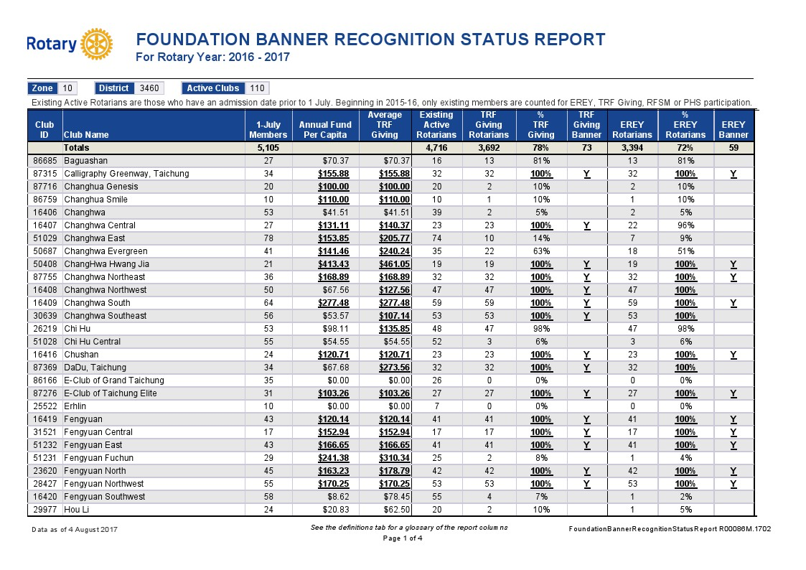

Slide 19
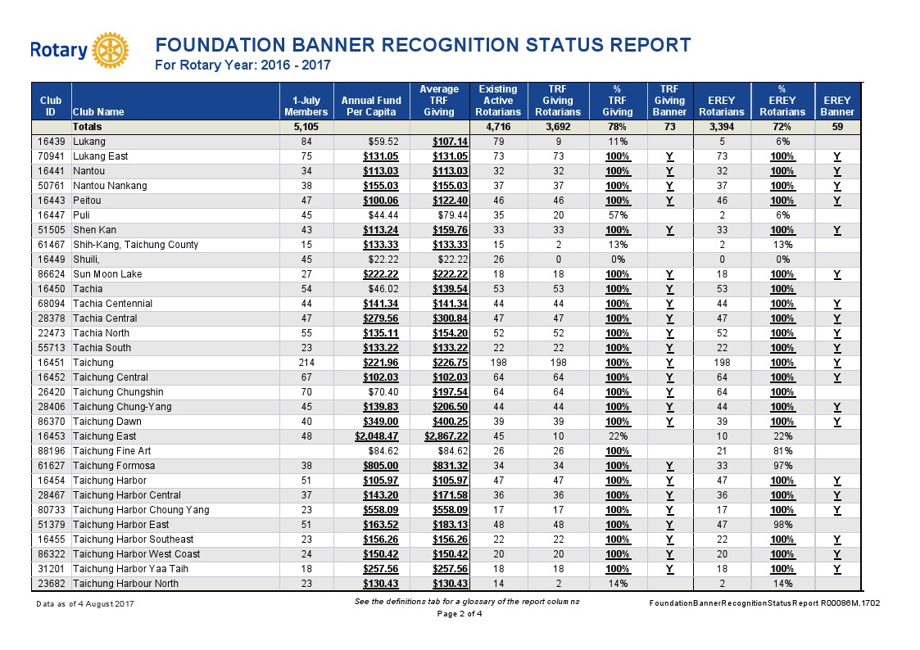

Slide 20
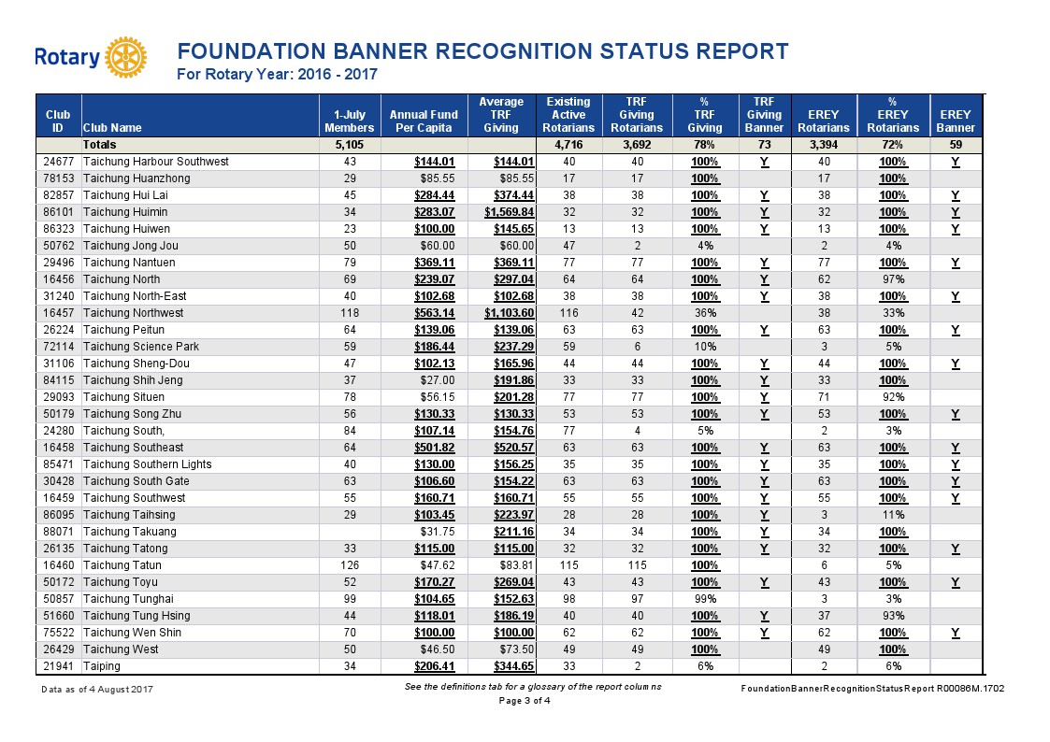

Slide 21
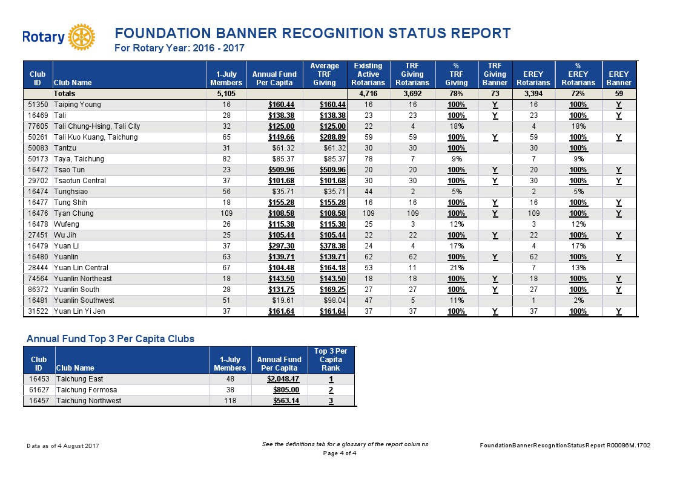

Slide 22
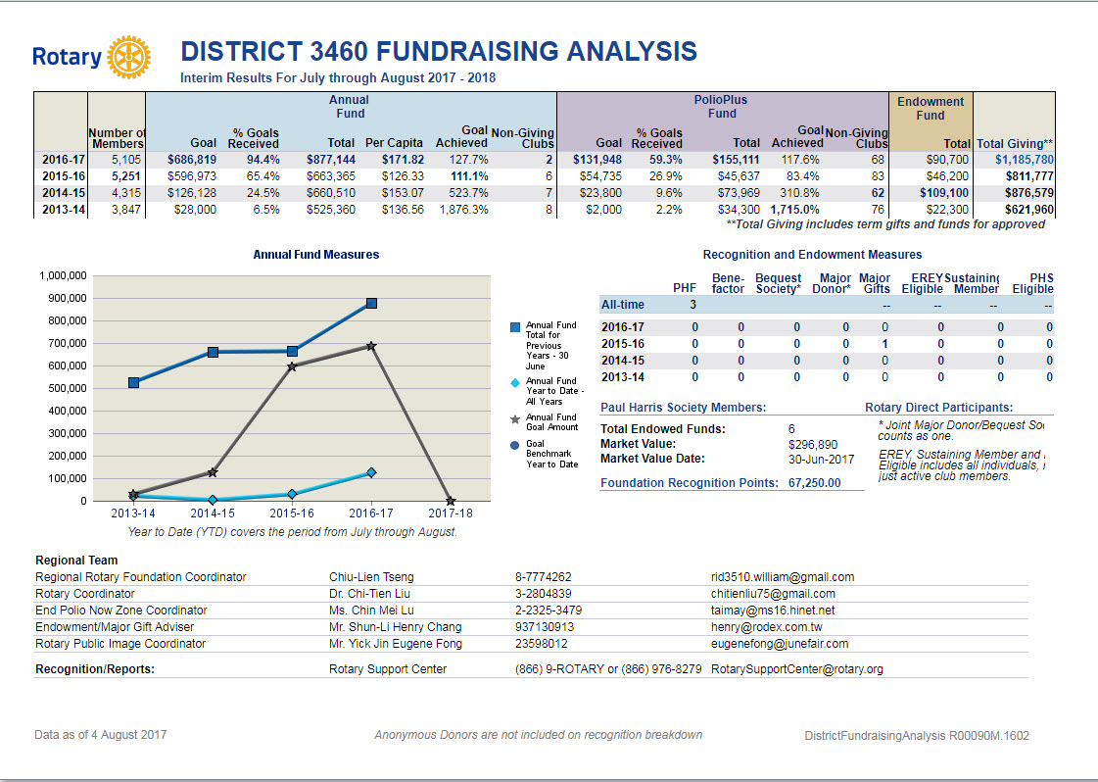

Slide 23
D3462
2017-18年度
地區獎助金

Slide 24
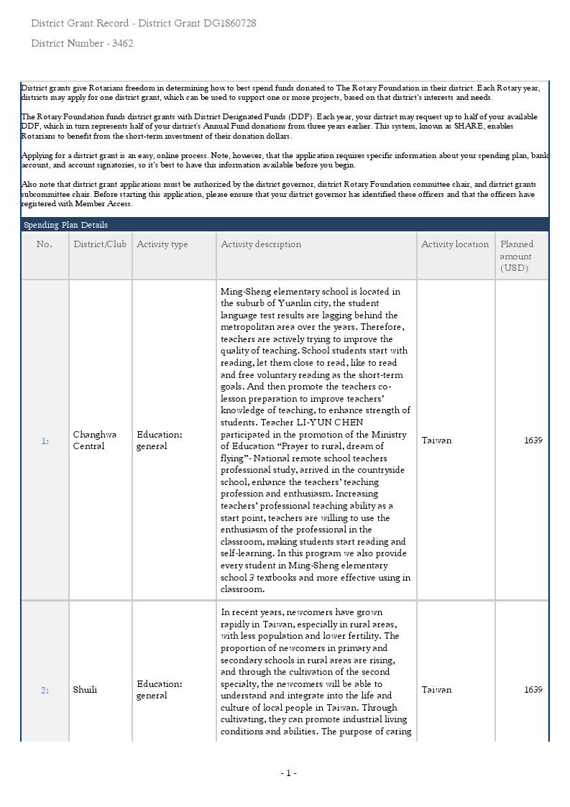

Slide 25
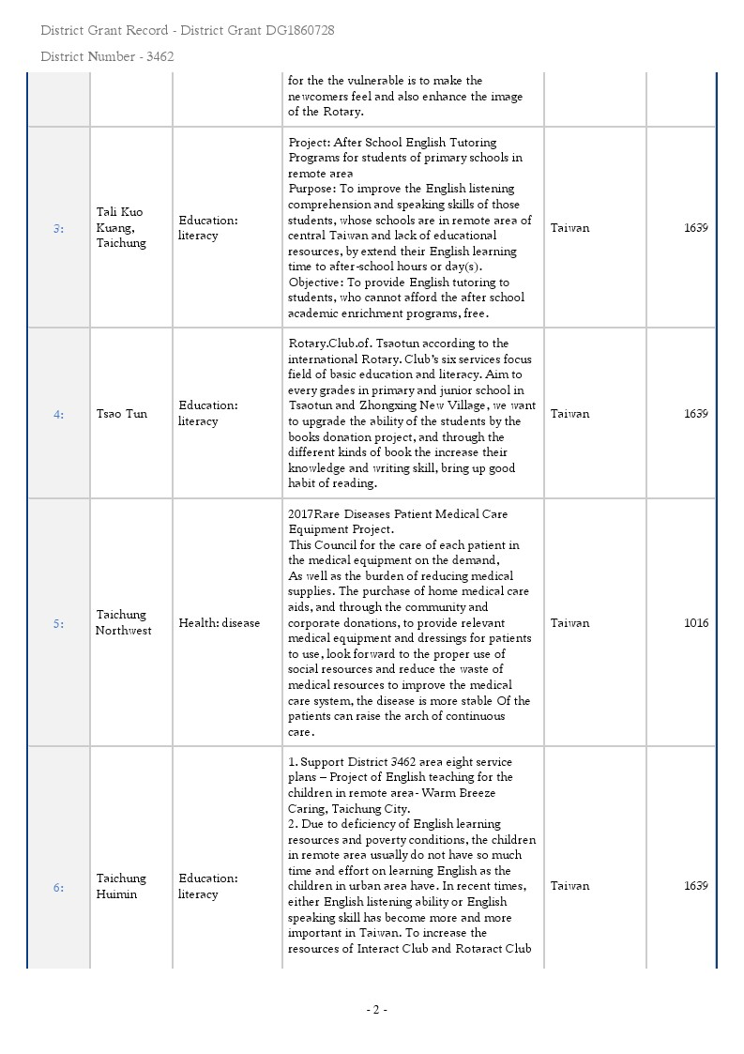

Slide 26
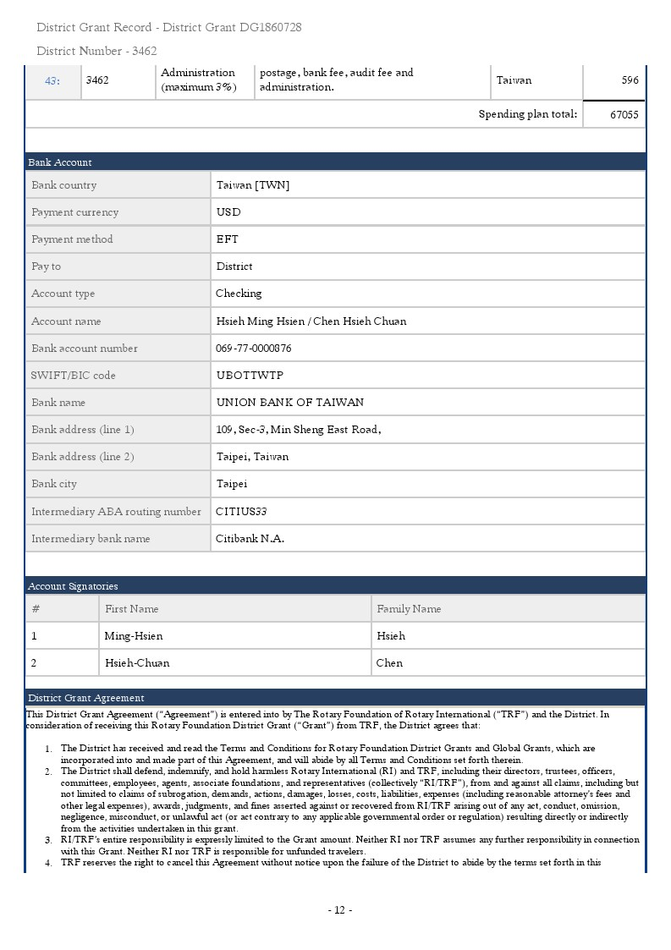
聯名帳戶

Slide 27


Slide 28


Slide 29
扶輪基金會的表彰 簡表
『個人 』表彰 | 『扶輪社』 表彰
扶輪基金會贊助會員 | 每位扶輪社員，每年扶輪社社旗 (每年頒發)
保羅‧哈里斯之友
保羅‧哈里斯協會 | 100%扶輪基金會贊助會員扶輪社社旗 (每年頒發)
多次捐獻保羅‧哈里斯之友
捐助者 | 年度計劃基金每位社員平捐獻前三名社旗 (每個地區，每年頒發)
遺贈會
鉅額捐獻者 | 100%保羅‧哈里斯之友社旗 (應要求頒發)
阿奇‧柯藍夫會
 | 根除小兒痲痺等疾病計畫感謝狀 (捐獻1500美元給根除小兒麻痺等疾病計劃的扶輪社)

Slide 30


Slide 31
扶輪基金會贊助會員
(Rotary Foundation Sustaining Member,RFSM)
扶輪基金會贊助會員是每年捐獻100美元或更多金額給年度基金的個人。這些捐獻也可計入保羅．哈理斯之友、多次捐獻保羅．哈理斯之友、保羅．哈理斯會、巨額捐獻人及扶輪社的表彰。請洽貴扶輪社社長以取得扶輪為感激此一捐獻成就而頒予的年度贊助會員名牌貼紙

Slide 32
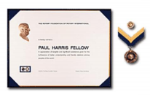
保羅．哈理斯之友
(Paul Harris Fellow,PHF)
保羅．哈理斯之友獎是感激捐獻（或以其名義捐獻）1,000美元或更多金額給年度基金、根除小兒痲痹等疾病計畫、或經過核准的扶輪基金會獎助金計畫的個人。保羅．哈理斯之友獎包含一份獎狀及徽章。另外可以15美元選購一個大獎章。

Slide 33

多次捐獻保羅．哈理斯之友
(Multiple Paul Harris Fellow,MPHF )
多次捐獻保羅．哈理斯之友獎頒予後續每捐獻 1,000 美元為一個等級的捐獻者。
$2,000 ∼ $2,999.99 ─ 1 顆藍寶石
$3,000 ∼ $3,999.99 ─ 2 顆藍寶石
$4,000 ∼ $4,999.99 ─ 3 顆藍寶石
$5,000 ∼ $5,999.99 ─ 4 顆藍寶石
$6,000 ∼ $6,999.99 ─ 5 顆藍寶石
$7,000 ∼ $7,999.99 ─ 1 顆紅寶石
$8,000 ∼ $8,999.99 ─ 2 顆紅寶石
$9,000 ∼ $9,999.99 ─ 3 顆紅寶石

Slide 34

保羅．哈理斯會
(Paul Harris Society,PHS)
保羅．哈理斯會是表彰承諾每年本身捐獻至少1,000 美元給年度基金、根除小兒痲痹等疾病計畫或經過核准的扶輪基金會獎助金計畫的捐獻者。

Slide 35

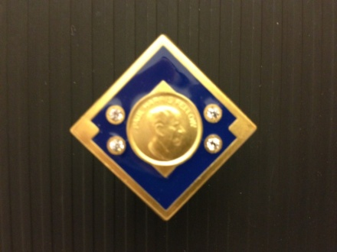
巨額捐獻人
(Major Donor,MD)
捐獻項目：年度基金、小兒麻痺、核准的獎 助金計畫、捐助基金或其他
資 格：個人捐獻累計或與配偶合計達 US$10,000(10顆)以上
$10,000 ∼ $24,999.99 ─ 第 1 級
$25,000 ∼ $49,999.99 ─ 第 2 級
$50,000 ∼ $99,999.99 ─ 第 3 級
$100,000 ∼ $249,999.99 ─ 第 4 級

Slide 36
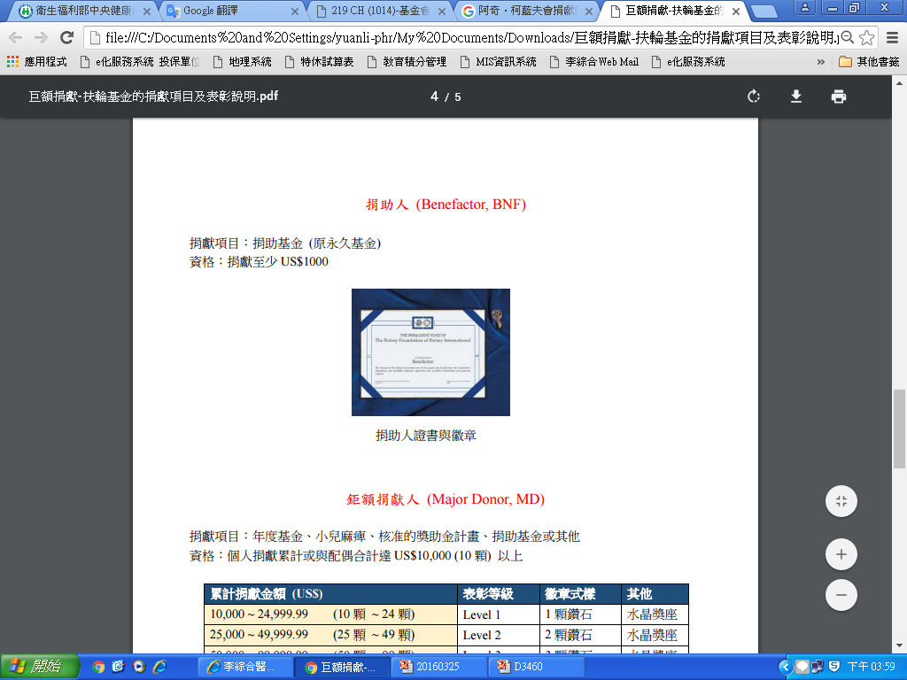
永久基金捐助者
(Benefactor, BNF)
捐助者是以書面通知扶輪基金會已在遺產計畫中規定捐贈至少1,000美元，或一次捐贈至少1,000美元給捐贈基金的個人。捐助者可獲頒一份獎狀及可搭配扶輪徽章或保羅．哈理斯之友徽章配戴的勳章。

Slide 37
遺 贈 會
(Bequest Society)
扶輪基金會頒予在遺產計畫中承諾捐獻10,000美元或更多金額的夫妻或個人。捐贈者在每個新的表彰級別可選擇獲頒一個水晶雕刻獎座及可配戴的徽章以資紀念。

Slide 38
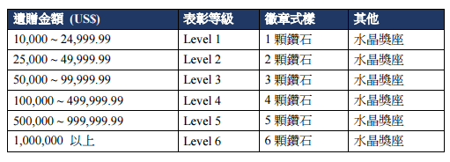
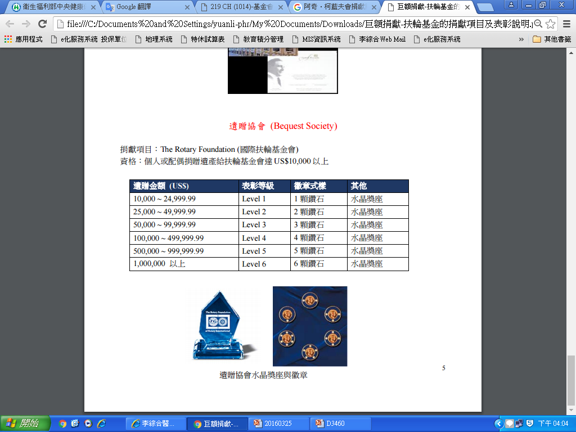
遺贈協會水晶獎座與徽章

Slide 39


Slide 40




每位扶輪社員每年扶輪社 Every Rotarian Every Year Club
100%保羅‧哈里斯之友扶輪社 100% Paul Harris Fellow Club
100%扶輪基金會贊助會員扶輪社 100% Rotary Foundation Member Club
年度計劃基金每位社員平捐獻前三名 Top 3 Per Capita inAnnual Programs Fund Giving)

Slide 41
E R E Y
EVERY
ROTARIAN
EVERY
YEAR
社友百分之百100%參與
社平均APF捐獻達 US$100
每位社友每年捐獻
Notes:
41

Slide 42
每位扶輪社員‧每年扶輪社
(Every Rotarian Every Year,EREY)
此一獎旗頒予達成平均每人捐獻至少100美元且社員百分之百參與且每位現職（繳交會費）社員於同一扶輪年度都捐獻一些金額給年度基金的扶輪社。此一年度表彰於該扶輪年度結束時頒贈。

Slide 43
百分之百保羅．哈理斯之友扶輪社
(100% Paul Harris Fellow Club)
扶輪社為符合獲獎資格，在申請此一獎旗時，社內每一位現職（繳交會費）社員必須皆為保羅．哈理斯之友。要獲得此一表彰，必須由一位扶輪社領導人聯繫地區總監，證實該扶輪社之資格，然後由地區總 監向扶輪基金會提交表彰申請。扶輪社可獲得一面獎旗，社名也將登入國際扶輪網站 www.rotary.org的百分之百保羅．哈理斯之友扶輪社名單。這面只可獲頒一次的獎旗，可於扶輪年度內隨時申請。

Slide 44
百分之百扶輪基金會贊助會員扶輪社
(100% Rotary Foundation Member Club)
此一獎旗頒予達成全社平均每人捐獻100美元，且社內所有現職（繳交會費）社員於同一扶輪年度中每人都捐獻100美元或更多金額給年度基金的扶輪社。此一年度表彰於該扶輪年度結束時頒贈。

Slide 45
年度基金每位社員平均捐獻前三名扶輪社
(Top 3 Per Capita inAnnual Programs Fund Giving)
此一獎旗頒予每一地區內平均每人平均捐獻前三名之扶輪社。要符合獲獎資格，扶輪社必須達成平均每人捐獻至少50美元給年度基金。此一獎旗於該扶輪年度結束時頒贈。

Slide 46
寶眷社員、衛星扶輪社員視同一般社員列入EREY與100%贊助會員社表彰計算。

Slide 47
年 度 基 金
AF – Annual Fund
年度基金：不指定用途
捐給永久基金、指定全球獎助金贊助、根除小兒麻痺、世界和平基金…都不算入EREY
年度基金捐獻是基金會的活血
-DDF的來源
Notes:
47

Slide 48
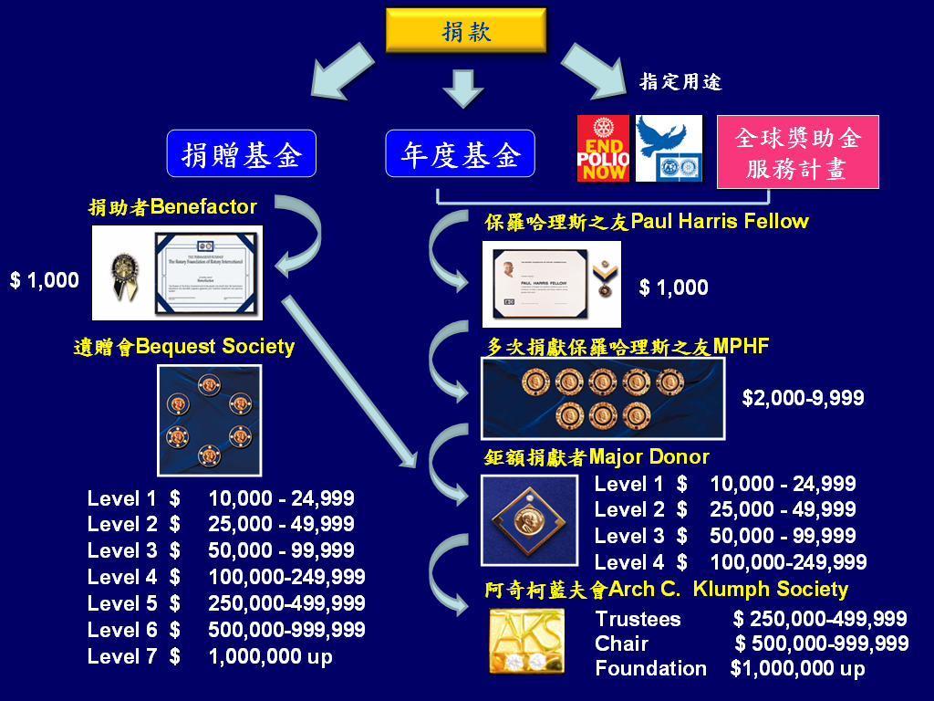
基 金 會 經 費 來 源
Foundation Funding
﹩1,000
﹩1,000

Slide 49




扶輪基金會資金來源及用途
捐
獻
指定用途
1000美金/每社
消除小兒痲痺
Endowed Fund
捐贈基金
Annual Fund
年度基金
50 %
50 %
扶輪國際研究中心
世界基金
地區指定基金
(DDF)
使
用
孳息
全球獎助金服務計畫
全球獎助金
地區獎助金
服務計畫
服務計畫
49

Slide 50


