Slide 1
基金管理職責
與
扶輪社資格認證
及
結案報告概述
Notes:
Welcome message

Slide 2
學習目標
確定良好的管理規範
了解作為扶輪社基金會管理人員的重要性
定義扶輪社的資格認證
Notes:
Review learning objectives.

Slide 3
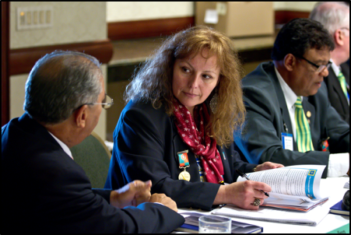
基金管理職責
管理職責：
是負責任的管理和監督贈款資金，確保資金得到正確使用並使有需要的人能受益。
Notes:
Stewardship is the responsible management and oversight of grant funds from The Rotary Foundation. Proper stewardship is the responsibility of each Rotarian.
Implementing good stewardship practices ensures that grants are well managed and that grant funds are used according to Foundation guidelines and benefit populations in need.
Careful grant management also sustains donor confidence in the Foundation and can increase donations.

Slide 4
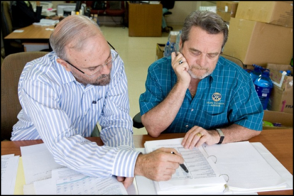
基金管理規範
有扶輪社員監督每個項目
實施項目核可 (批准)
遵循標準商業慣例
報告不規則項目
提交報告
保留文件
Notes:
Stewardship includes:
Project supervision by Rotarians who are actively involved in the project and who ensure that the grant terms and conditions are followed
Implementing projects as approved by the Foundation, or having the Foundation approve any changes
Following standard business practices, such as limiting the use of cash for transactions and maintaining a record of all transactions
Reporting irregularities to the district so that stewardship issues can be properly investigated and resolved
Submitting timely, complete, and accurate reports to the Foundation to verify how funds were spent
Retaining appropriate documents

Slide 5
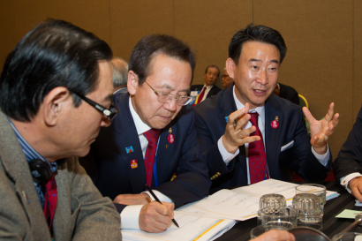
基金管理 實務
報告追踪
日常監測
調查指控
管理研討會
認證合格
Notes:
The Foundation oversees grant fund stewardship in these ways:
Tracking reporting compliance
Monitoring by The Rotary Foundation Cadre of Technical Advisers
Investigating allegations of mismanagement
Providing stewardship seminars
Managing the qualification process

Slide 6
資格認證
為扶輪社提供管理資助活動的財務和管理控制
扶輪社在申請全球獎助金之前需要符合認證條件
Notes:
Clubs need to be qualified by their districts before they receive global grant funds from the Foundation. Qualification ensures that your club has proper financial and grant management practices in place to manage Rotary Foundation funds.
Clubs need to be qualified every year in order to receive global grant funds. The district decides whether its clubs need to be qualified to receive district grant funds.

Slide 7
資格認證需求
參加 扶輪基金管理研習會GMS
閱讀，簽署並將扶輪社諒解備忘錄MOU提交給所屬扶輪地區
前一年度扶輪社須至少捐贈扶輪年度基金USD$500.
Notes:
The Rotary Foundation has two requirements for club qualification:
The president-elect or a designated club representative must attend the grant management seminar.
The club president and president-elect must read, sign, and submit the club MOU to their district and agree to follow its requirements.
A district may have additional requirements.
<<If the district has additional qualification requirements, list them here.>>

Slide 8
扶輪基金管理研習會
GRANT MANAGEMENT SEMINARS
GMS 於2017/04/08舉行完畢。
地區獎助金DG審核公告：2017/07/25
District Grant DG1860728
Notes:
<<Give the dates of planned grant management seminars and any other information about them that participants should have.>>

Slide 9
扶輪社簽署MOU
CLUB MEMORANDUM OF UNDERSTANDING
扶輪社諒解備忘錄MOU是扶輪社及扶輪地區之間有約束力的協議。 它概述了基金會的要求。
通過簽署諒解備忘錄，扶輪社同意遵守要求。
Notes:
The club memorandum of understanding (MOU) is a binding agreement between the club and its district. It explains the measures the club is required to undertake to ensure proper grant activities and management of Rotary Foundation grant funds.
By signing this document, the club agrees that it will comply with all Foundation requirements.

Slide 10
SESSION REVIEW
確定良好的管理規範
了解作為扶輪社基金會管理人員的重要性
定義扶輪社資格要求
Notes:
Review the session’s learning objectives that were covered.

Slide 11
要如何做？ TAKE ACTION
參加獎助金管理研習會GMS
審閱地區財務管理政策
Notes:
Review action items and ask participants for additional items.

Slide 12
Questions?
qualification@rotary.org
Notes:
Ask participants for questions.

Slide 13
結案報告概述(一)
A. 申請及執行
1. 參加扶輪基金管理委員會講習
2. 簽署MOU 後才能 提出申請
3. 地區扶輪基金會審核—通過
4. 申請社執行獎助金計畫
5. 提出結案報告
6. 地區扶輪基金會審核—通過
7. 撥款 (DDF專戶—扶輪社帳戶)。
Notes:
Review action items and ask participants for additional items.

Slide 14
結案報告概述(二)
B. 結案報告內容
1. 計畫內容須與申請通過時一致。
2. 經費項目與申請通過時一致。
3. 避免產生委外作業。
4. 核銷單據需項目分明，
避免以總額為之。
5. (實例說明)。
Notes:
Review action items and ask participants for additional items.

Slide 15
Questions?
3462dg1718@gmail.com
ask@rotary3462.org.tw
bv5af@ms1.hinet.net
Notes:
Ask participants for questions.

