Slide 1
分享制度及鉅額捐獻
PDG Doctor P-J Lin
D3462 DRFC chair

Slide 2
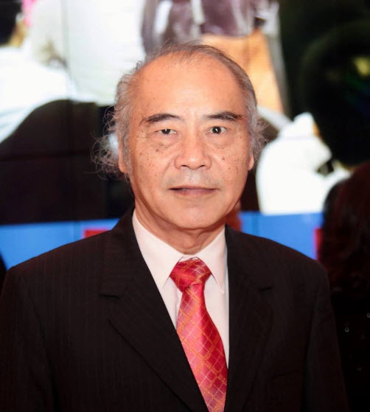
林伯龍 Doctor簡介
扶輪社： 彰化中區扶輪社
入社： 1993年
1994 台北世界年會無線電通信規畫
1999-00 D3460 GSE主委
2001-02 社長
2004-05 助理總監，地區巨額捐獻主委
2005-06 地區Polio-Plus主委
2008-09 地區副秘書長
2011-12 地區助理總監、DGN
2013-14 D3460 DG，地帶研習會Panelist
2015-16 地區訓練師，Z10B ARC，
地帶研習會分組與談人、報告人，
地區獎助金主委
2016-17 Z10B ARC，地區訓練師，
地帶研習會分組與談人，
地區獎助金主委。
2017-18 3462地區扶輪基金會主委，地區訓練師。
表彰：巨額捐獻人
RI超我服務獎

Slide 3
p

Slide 4
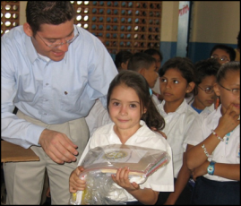
支持扶輪基金會
5
根除小兒痲痺基金
立即消除小兒痲痺
年度基金
支援目前
捐贈基金
確保未來
50%
50%
孳息
分享制度
世界基金
地區指定基金
DDF
全球獎助金
地區獎助金

Slide 5
分享制度
捐獻年度基金分配:
50% 地區指定基金 (DDF)
50% 世界基金 5% 指定用於行政支援
3年之投資週期
將捐款轉換為獎助金
允許地區控制如何分配DDF
Notes:
Welcome message

Slide 6
分享制度分配
$1,000
捐獻
$500
DDF
$500
世界基金

Slide 7
DDF與世界基金
地區指定基金(DDF)
-由地區分配
-由地區內之扶輪社員運用
-可使用於國內或國外
-使用於基金會之獎助金或計畫
世界基金
-由基金會保管人分配
-由全球扶輪社員運用
-可運用於配合款
-使用於基金會之獎助金或計畫

Slide 8
分享制度程序
2014-15
2015-16
2016-17
2017-18
2018-19
募款
使用基金
計算出未使用之DDF餘額;
於5月通知地區
未使用之DDF移轉入下一年度; 於10月通知地區
Notes:
Looking at the timeline here, we see funds being spent on district activities in 2014-15.
Any unused DDF (that is, funds remaining after all approved grant applications and donations have been reported to the Foundation) from 2014-15 will be rolled over into 2015-16.
These rollover funds cannot, however, be used toward a 2015-16 district grant.

Slide 9
SHARE
2014
2015
2015
2016
2016
2017
2017
2018
2018
2019
2019
2020
2020
2021
DDF
$134,110
50%
50%
DDF
$660,510
年度基金
歸屬3462地區之50%
$109,100
捐贈基金
$106,969
其他捐贈
Notes:
Funds used for projects in current year were provided by Rotarians three years ago. Money because of the motivational efforts of predecessor.
Responsibility is to provide motivation to district to leave more opportunity for district leadership three years hence.
Highlight fact that all funds may not be used.
Highlight that all unused DDF will roll forward to the next year so it will be available for immediate use.
Highlight that all returned DDF for cancelled projects will become available in the current year for immediate use.

Slide 10
彌補營運費用之不足

Slide 11
新的營運費用資金模式 2015-7-1生效
Notes:
Beginning 1 July 2015, we will be setting aside additional sources of funds to pay for the Foundation’s operating expenses if they are needed.
Annual Fund investment earnings (shown in dark blue) will continue to be the primary source of funds, but they will be supplemented by some additional sources.
5% of contributions to the Annual Fund will be set aside to pay for operating expenses and/or to build the operating reserve. This includes contributions designated to SHARE and to Areas of Focus. Contributions to Areas of Focus would result in 95% of the contribution supporting the Area of Focus program and 5% would be allocated to Operating Expenses. 5% of Annual Fund Contributions will provide about 20% of the funding sources and is shown in pink.
5% of cash contributions to fund global grants will also be set aside. This amount is shown in the lighter blue. Given cash contributions are not invested for three years, they do not generate any earnings to help pay for the costs associated with processing those contributions.
Shown in yellow are the Endowment Fund spendable earnings, which currently provide some funding for operating expenses.
Why did we make a change to our funding model?
Thanks to the generosity and hard work of Rotarians, our Foundation has been Doing Good in the World for almost a century.
Through the years, our practice was to fund operating expenses with returns from investments. While this worked well during good years, it did not safeguard the Foundation’s future viability.
To ensure that we can continue this good work, a new funding model that will secure the Foundation’s future has been approved.

Slide 12
分享制度 2015-7-1生效
$1,000
捐獻
$500
DDF
$500
世界基金
保留$50用於行政支援
最多可使用$250於地區獎助金
以1:1之比例配合DDF用於全球獎助金DDF及世界基金也可資助消除小兒麻痺及和平中心
*未使用之DDF餘額會轉入下一年度。
*如果投資收益不敷行政費用時，捐獻金額之5%可使用於行政支援。

Slide 13
鉅額捐獻人 Major Donor
個人累積捐獻扶輪基金會金額達美金1萬元以上。
表彰鉅額捐獻人共分為4級:
第一級 $10,000 --- $24,999
第二級 $25,000 --- $49,999
第三級 $50,000 --- $99,999
第四級 $100,000 --- $249,999

Slide 14
AKS阿奇柯蘭夫會
個人捐獻扶輪基金會達美金25萬以上。
AKS表彰共分為6級:
第一級: $250,000 --- $499,999
第二級: $500,000 --- $999,999
第三級: $1,000,000 --- $2,499,999
第四級: $2,500,000 --- $4,999,999
第五級: $5,000,000 --- $9,999,999
第六級: $10,000,000 以上

Slide 15
表彰
 | 2015-16 | 累計
阿奇柯蘭夫會會員 | 57 | 658*
巨額捐獻 | 2,574 | 26,035
遺贈會會員 | 594 | 11,908
捐獻人 | 2,449 | 97,392
保羅哈理斯之友 | 54,271 | 1,570,186

Slide 16
阿奇柯蘭夫會會員等級分類
Total members as of 30 June 2016: 658

Slide 17
阿奇柯蘭夫會會員前十大國家

Slide 18
謝謝

